Slide 1
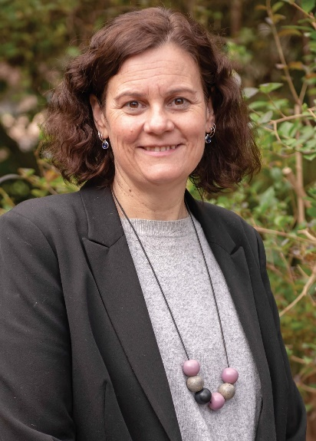
Principal's Welcome
Dear parents and caregivers,
It has been yet another busy but productive couple of weeks at the college.
Yesterday we had the pleasure of hosting our official opening.
For the founding staff members at the college, this was a very significant and emotional event. After 15 months of planning and then 2 years and 7 weeks of operating as a school, we are officially open. I would like to say a huge thank you to all staff involved in this special event. I want to make special mention of our school band who performed at the official opening. They were truly amazing and made me feel so very proud of what the students at the college can achieve.
Other recent highlights have included the Flexible Learning activities morning and the Spencer Gulf meet and greet evening for parents. It was great to see so many of our students so actively involved in a range activities at the Flexible Learning activities morning. It was also great to see so many families at the recent Spencer Gulf meet and greet event.
Other college events include;
- VET block week
- ABC news interview with students
- SAASTA tour of Whyalla
- NAPLAN testing
- Student leadership conference in Adelaide
- Emergency drill and an evacuation
Year 10 immunisations
Our first governing council meeting
The SA SRC announcement
Teen Parliament event
SAASTA visit to Cowell
Whyalla City Council and Headspace period pride drop in sessions
Census day
ACE workshop
Spencer Gulf meet and greet evening
Financial audit
On behalf of the college I would like to congratulate our Numeracy Leader, Katie Lee and husband Ryan on the birth of their first baby, a girl named Bridie. Congratulations to you both and welcome to parenthood.
Congratulations also to Megan Cox, who starts with us on Monday in the VET/Pathways Officer role. We are very excited to be welcoming Megan back to the team. Corey King also starts at the college on Monday as an SSO, and Kylee Seabrook will join the team, as a teacher mainly in years 7 and 8. We have also welcomed SSO’s Caitlin Brice and Vicky Antoniadis to the team.
Due to both illness and COVID, which has really impacted the college over the past few weeks, our Connected Self PD scheduled for last Friday, has been moved to Monday 3 June. Last Friday staff spent the day undertaking curriculum programming and planning instead.
Finally, a reminder that next Thursday is World Down Syndrome Day, so don’t forget to wear your crazy socks to school.
My quote for this newsletter is:
“The beautiful thing about learning, is that nobody can take it away from you”
Tricia Richman
Important Dates
NAPLAN
Wednesday 13 to Monday 25 March
Harmony Week Monday 18 to Friday 22 March
ACE Workabout Centre Block Week
Monday 18 to Friday 22 March
Adelaide
AFL Cup Visit
Tuesday 19 March (2-2.40pm)
International Day of Happiness
Wednesday 20 March
National Close the Gap Day
World Down Syndrome Day
Thursday 21 March
Stage 2 Visual Art Camp (Adelaide)
Thursday 21 to Friday 22 March
VET Block Week
Monday 25 to Thursday 28 March
WASSAC Carnival (Port Augusta)
Tuesday 26 March
Learning Conversations
5.30 – 7.30pm
Tuesday 26 March
T20 Cricket (Port Pirie)
Year 9 & 10 Boys
Wednesday 27 March
Good Friday
Friday 29 March
Easter Monday
Monday 1 April
House Madness/Red Day/ House Colours Day
Tuesday 2 April
Autism Awareness Day
Tuesday 2 April
Year 9 Camp 1 (A/B/F)
Tuesday 2 to Friday 5 April
Year 7 Camp 1 (A & B)
Wednesday 3 to Friday 5 April
Finance & Governing Council
Wednesday 3 April
Year 9 Camp 2 (C/D/E)
Monday 8 to Thursday 11 April
Year 7 Camp 2 (C & D)
Monday 8 to Wednesday 10 April
Spencer Gulf Aquatics
Monday 8 April
Health Science Camp
Tuesday 9 to Friday 12 April
Year 7 Camp 3 (E & F)
Wednesday 10 to Friday 12 April
Last day of Term 1
Friday 12 April
Early Dismissal (2.30pm)
P: 8668 9600 117 Nicolson Avenue, Whyalla Norrie, 5608 E: dl.1035.info@schools.sa.edu.au W: www.wsc.sa.edu.au
Week 7, Term 1, 2024
Trish's quote

Slide 2
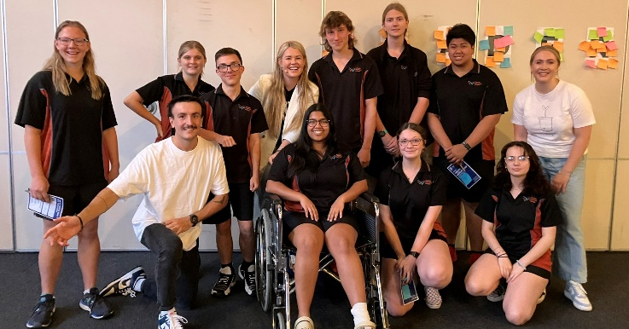
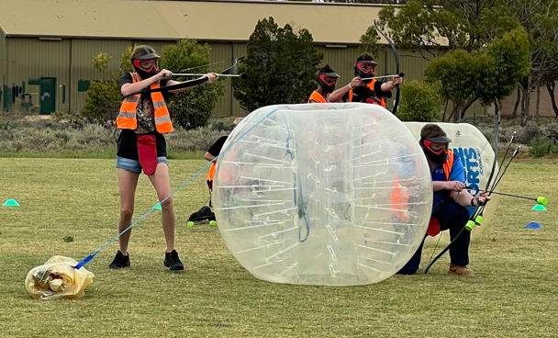
College Updates
Governing Council Easter Fundraiser
From 1 March 2024, new laws came into affect to ban smoking and vaping in a variety of public outdoor areas in South Australia.
Regulations under the South Australian Tobacco and E-Cigarette Products Act 1997 are being introduced to address risks associated with passive tobacco smoking and passive inhalation of e-cigarette aerosol.
A person who smokes or uses e-cigarettes in a public place area declared by the regulations to be a public area in which smoking is banned is guilty of an offence. The maximum penalty is $750 + $105 expiation fee. To find out more, head to:
https://www.sahealth.sa.gov.au/.../smoking+the+rules+and.../
Whyalla Secondary College Governing Council are conducting a Kytons Easter Fundraiser. Orders are now open and will close Wednesday 20 March for delivery on Tuesday 26 March. Orders can be made through the Qkr! app or by order form available at the front office.
Flexible Learning Activities Morning
The college responds to the needs of young people in our school through the creation of Flexible Learning programs. We provide young people with an opportunity to engage in education in an adaptable and supported learning environment.
Our Flexible Learning Programs offer educational pathways for young people across years 7-12 who have engaged in learning in a variety of ways.
Our Flexible Learning staff work with young people to:
• improve cognitive and academic skills
• enhance social and emotional competency
• strengthen cultural and spiritual life
• help find employment or further training
• build community connection
Recently, our students engaged in authentic opportunities through an exciting and diverse range of subjects, which provided an individual, active learning experience.
Students experienced the following activities: Bubble Soccer and Archery Tag by Xtreme Kites and Paddle, Clontarf Longer Kick and Table Tennis, Centacare Garden Games, Shooting Stars Craft, Pancake Breakfast and ESports
A fundamental component of flexible learning is an emphasis on relationship development, which draws on our ATRiUM principles and relates to the life experiences of young people. Our students had a fantastic time getting to know one another and their teachers in the space!
Youth Leadership Camp
Nine WSC leadership students recently took part in the Youth Leadership Academy Australia conference. This program was designed to inspire, strengthen and empower secondary school leaders. Throughout the day students focused on 3 key areas of learning; self-discovery, empowerment and leadership development.
They had the chance to learn from and collaborate with many quest speakers, one of them being Wil Massara. Wil is a 21 year old social entrepreneur and changemaker, and founder of Youth Leadership Academy Australia.
Week 7, Term 1, 2024

Slide 3
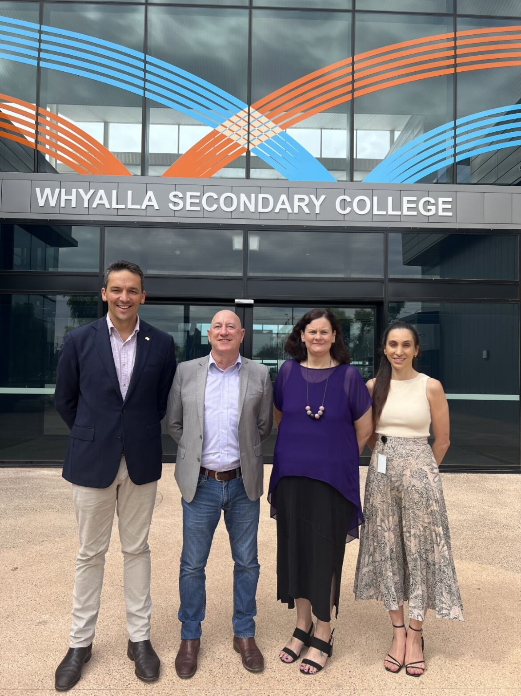
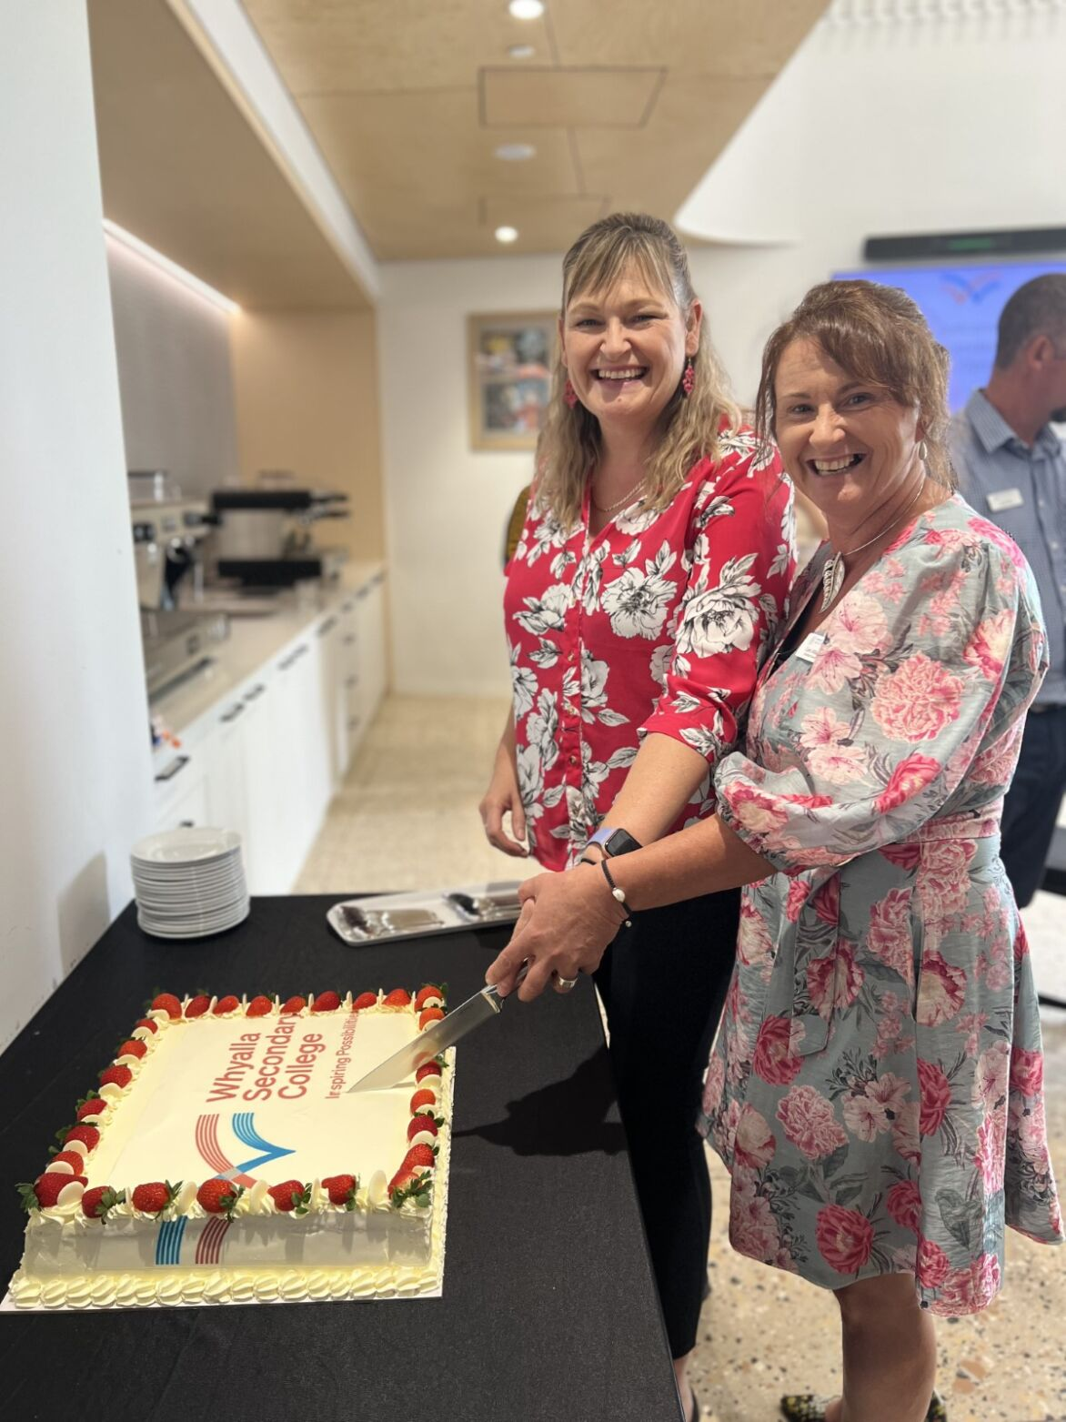
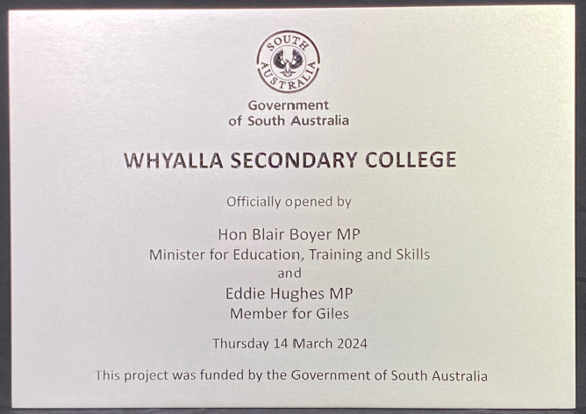
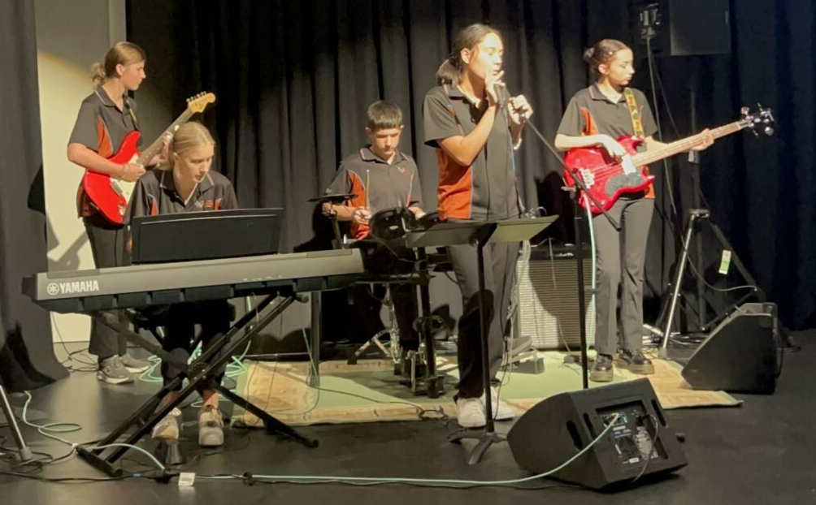
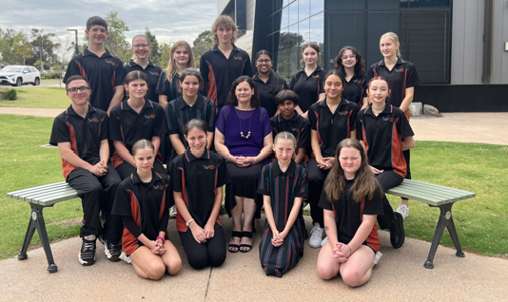
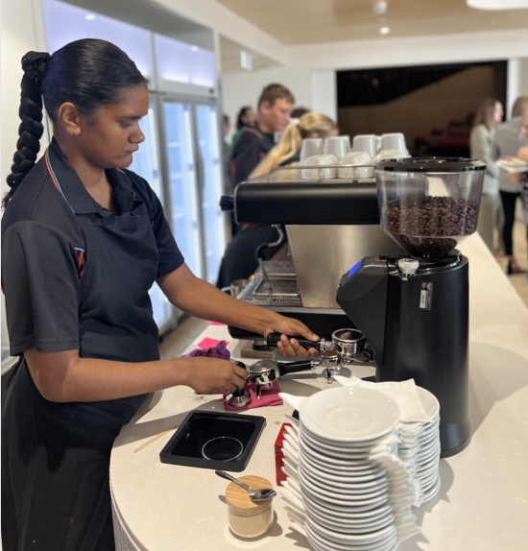
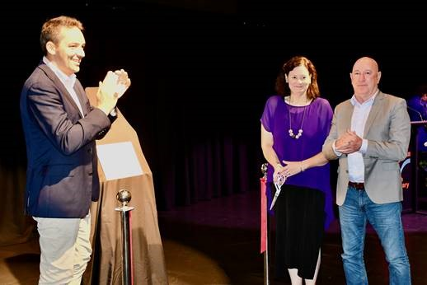
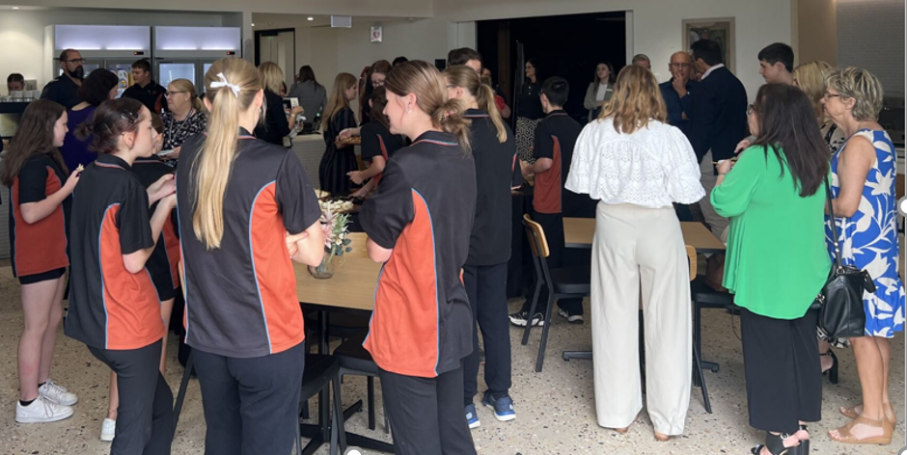
Official Opening
Yesterday we had the pleasure of hosting our official opening with state and local government dignitaries, as well as site planning and building officials. It was wonderful to finally celebrate our opening and share our journey.
Honourable mentions to the Minister for Education, Training and Skills, Blair Boyer MP and Eddie Hughes MP, Member for Giles, who joined Principal Tricia Richman and the team for the unveiling of the official plaque.
Week 7, Term 1, 2024

